Slide 1

Tata Data Visualization: Empowering Business with Effective Insights
Created by – Divya Pardeshi

Slide 2
Table of Contents
Introduction
Revenue by Month, 2011
Top 10 Countries by Revenue and Their Quantities
Top 10 Customers by Revenue
Revenue by Country

Slide 3
Introduction
I’m Divya Pardeshi, and I’m excited to share some insights about your business. Thank you also for the questions you asked since they provided a general direction for the kind of insights you are looking to get from this analysis. I hope you find the analysis compelling and helpful as you make decisions regarding future business opportunities.
I’ve provided the most up to date and error free analysis. After I loaded the data into my software, I checked any records that have negative quantities and unit price, as these records needed to be removed in order to provide helpful analysis.
I appreciate the opportunity you gave me to dive into this data to gain insightful information about the store’s performance.

Slide 4
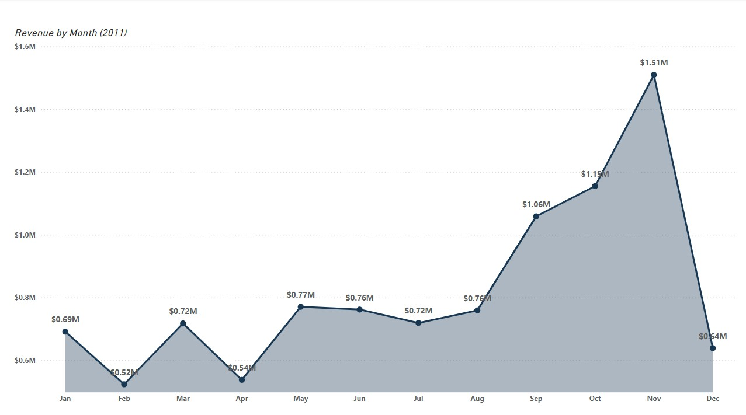
Revenue by Month, 2011
Revenue remained relatively stable during the first eight months.
The retail store experienced exceptional growth in the final four months of the year.
Starting in September, revenue surged, increasing by 40% compared to the previous month, and peaking at $1.5 million in November.
This analysis shows that the retail store sales are impacted by the seasonality which usually occurs in the last 4 months of the year.

Slide 5
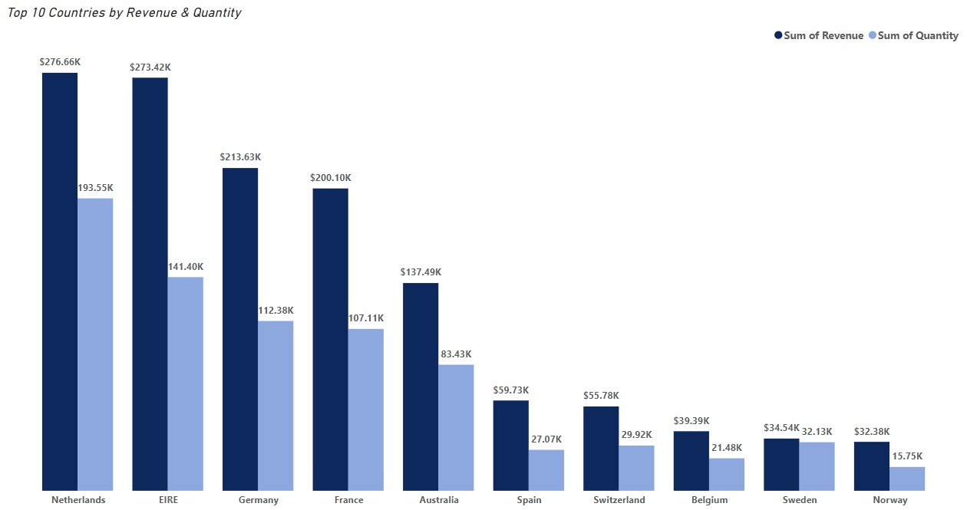
Top 10 Countries by Revenue and their Quantity
The data identifies 10 countries with potential for growth, excluding the UK due to its high demand.
Netherlands, Ireland, Germany, and France stand out as countries with high volumes of units bought and revenue generated.
These countries represent significant opportunities for capturing and expanding market share.

Slide 6
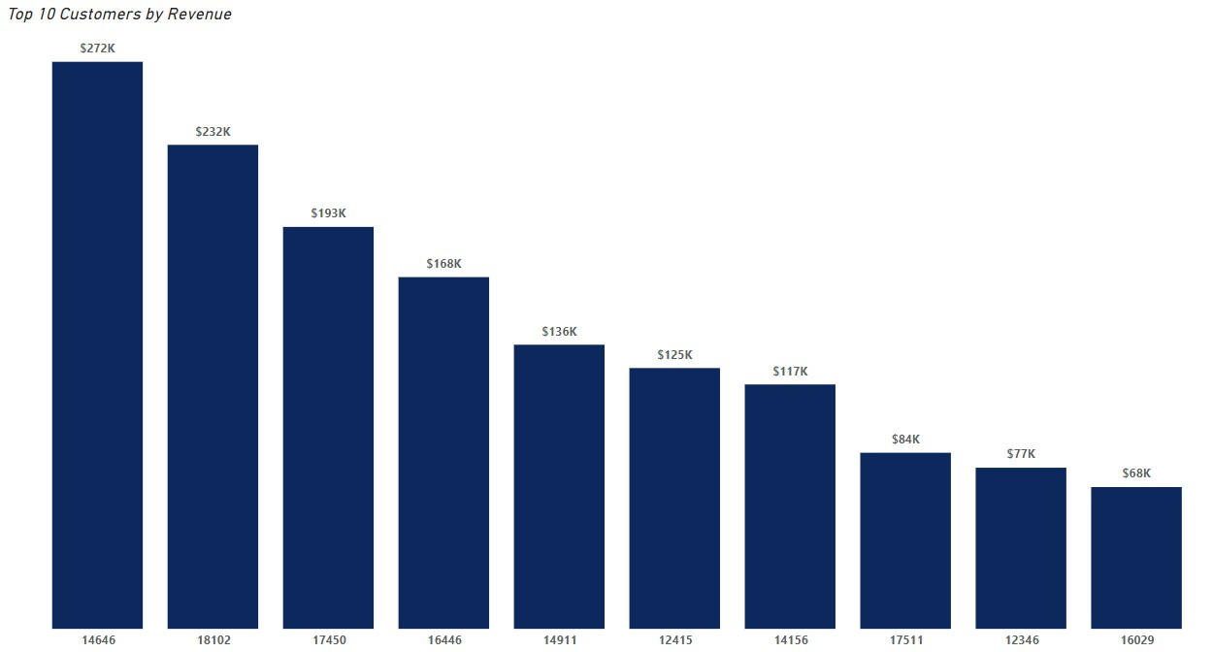
Top 10 Customers by Revenue
The data shows that there is not much of a difference between the purchases made by the top 10 customers.
The highest revenue generating customer only purchased 17% more than the 2nd highest which shows that the business is not relying only on a few customers to generate the revenue.
This shows that the bargaining power of customers is low and the business is in a good position.

Slide 7
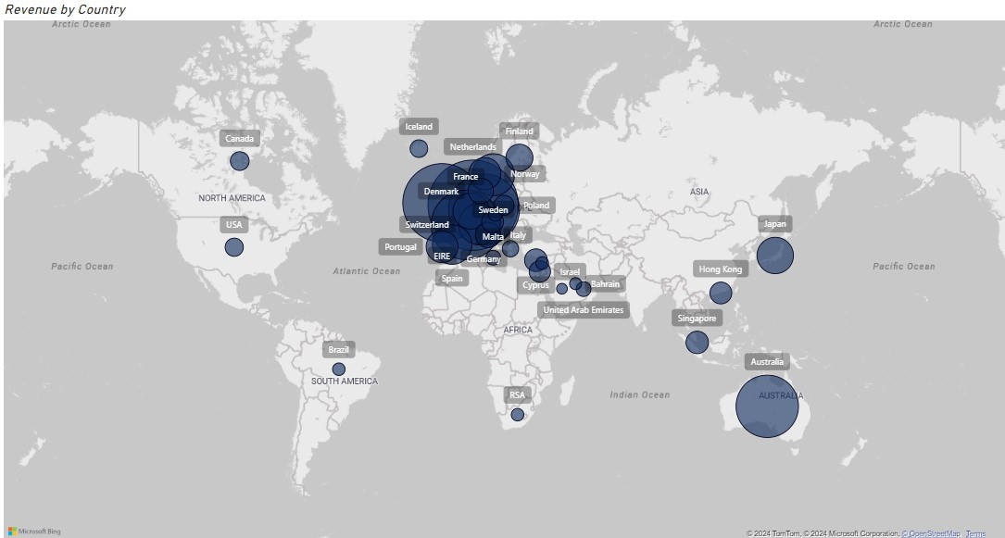
Revenue by Country
Netherlands, Ireland, Germany, France, and Australia are generating substantial revenue and represent strong growth opportunities.
The majority of sales are concentrated in Europe, with limited presence in the Americas and no demand in Africa, Asia, or Russia.
Targeting new regions like Africa, Asia, and Russia presents significant opportunities for boosting sales and profitability.

Slide 8
Thank You

